Slide 1
Introduction
to Python

Slide 2
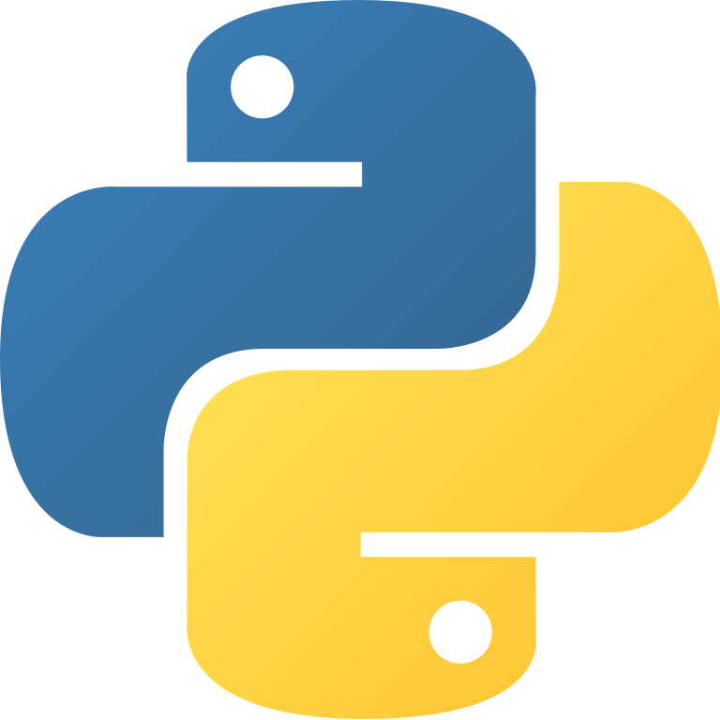
What is Python?
Python Programming language, one of the most popular languages in the world, is a general-purpose, high-level programming language used in Artificial Intelligence and Data Science in general
Created by Guido van Rossum in the late 1980s
It uses Functional Programming and Object-oriented programming logic
It has a dynamic and modular structure

Slide 3
Where to use?
Web Development (Flask,Django)
Graphical User Interface (Kivy,PyQt,Tkinter)
Network Programming (Asyncio,Diesel)
Web Crawler, Spider (Scrapy)
Machine Learning and AI (Tensorflow, Scikit-Learn, Numpy, Pandas etc.)

Slide 4
Why do we use Python?
It is a language that is easy to learn and simple to develop compared to other languages
It is a compilable language. Developers and engineers can change some of the code and see the result faster than compiled languages
Thanks to its flexibility, it allows to develop projects with different programming styles such as Imperative, Functional, Procedural, OOP
Since it is platform independent, it can easily work in any system
Community support of Python is growing day by day
It can be used in fields such as Data Science, Web Development as well as Artificial Intelligence projects

Slide 5
Why Python Is Considered The First Step To AI?
Because it is an easy language to develop, developers and engineers can focus on the problem, not the intricacies of the language, when developing an AI model or working on a Data Science project.
It has a large Data Science and Artificial Intelligence library ecosystem
It is faster than compiled languages. This reduces the waiting time in projects where models that already have a long training period are developed.

Slide 6
Colab Time!

